Slide 1
Web Tech 2 Project
PES University
By:
Bilal Shakil Belgaumwala 01FB16ECS091
Ashish Sanu 01FB16ECS075
Chetan 01FB16ECS096

Slide 2
Technologies Used
-CSS,Javascript,PHP
Database Used
-Sqlite3
Framework Used
-Flask
What was implemented
Ajax Patterns, RSS Feeds, COMET Technique

Slide 3
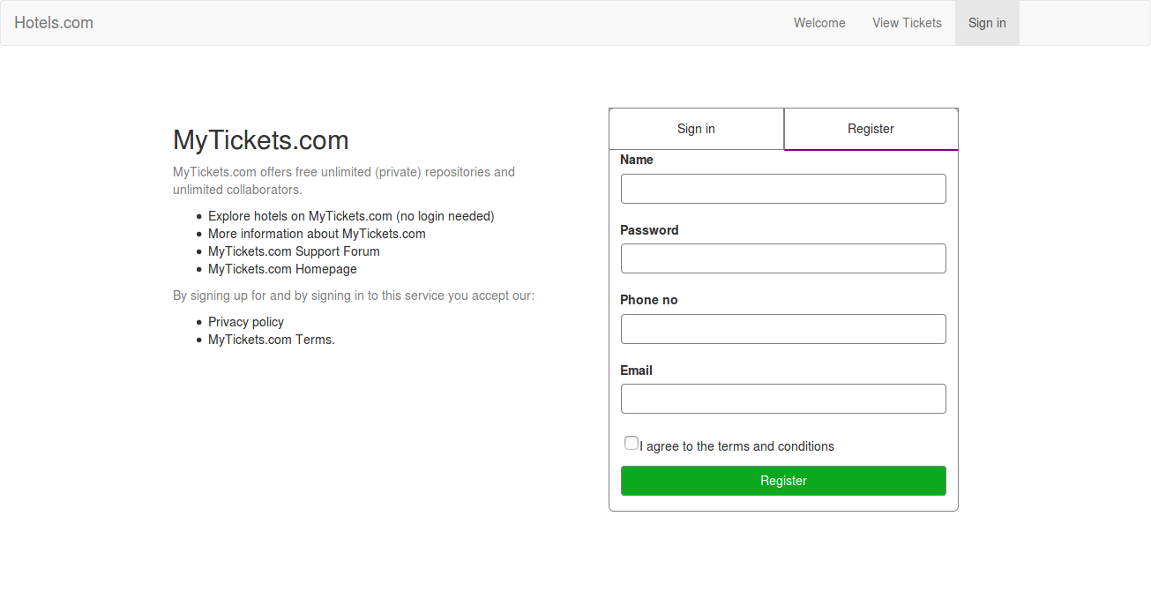
Components of the Website
Registration and Login Page:
-Uses a hidden frame for registration.
-Implements Submission Throttling to confirm if a name or number is available.
-Sends an email and an OTP

Slide 4
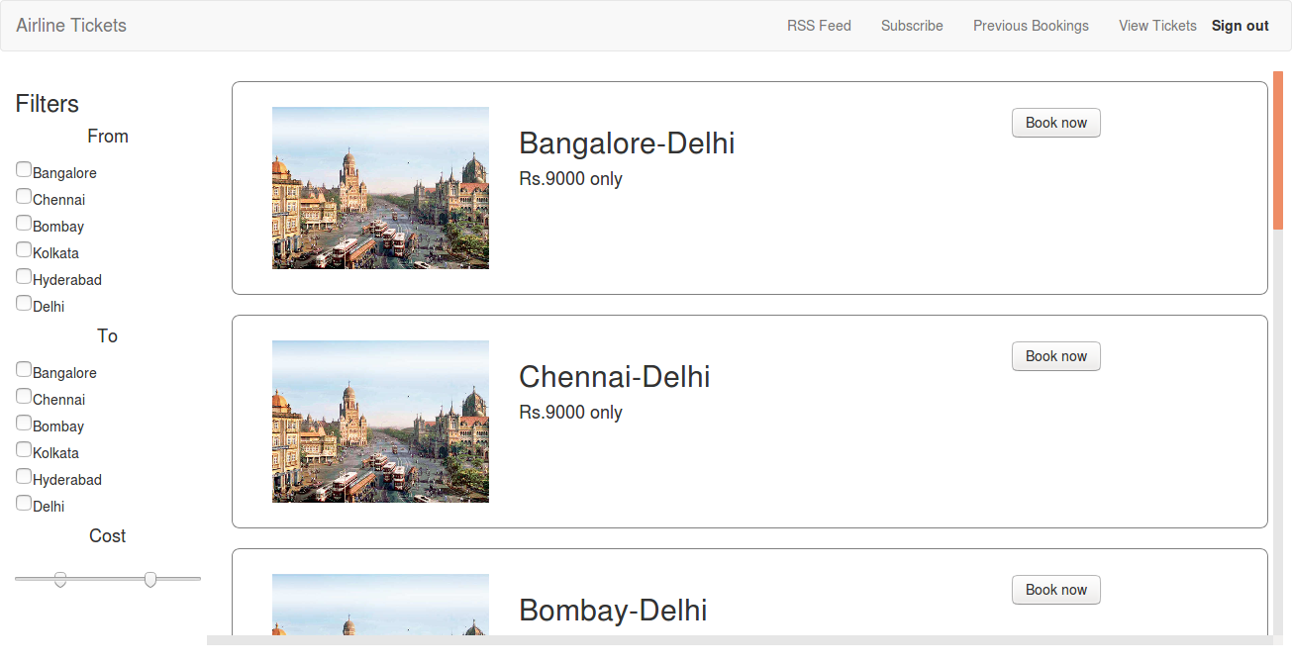
Tickets Page
-Uses multistage downloading to load the components of the page.
-Static CSS and JS files are sent separately
-Also implements Long Polling to keep track of dynamic pricing of the tickets.

Slide 5
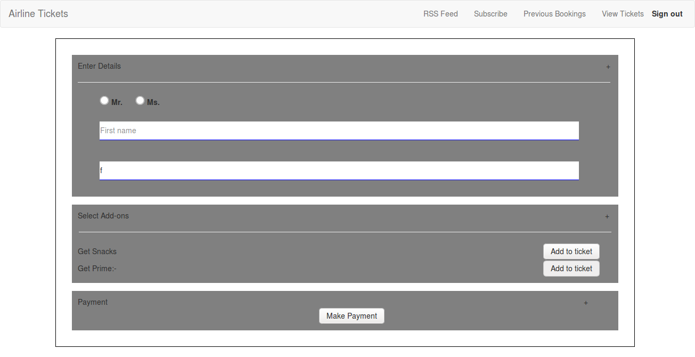
Booking
-Implements Predictive Fetch
-Static JS and CSS files are sent separately
Intelligent Component
-Calculate the discount the user gets.

Slide 6
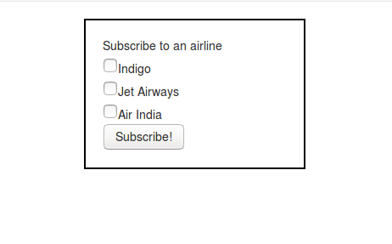
Subscribe
-Subscribe to an RSS feed of your choice.
-Can be modified.

Slide 7
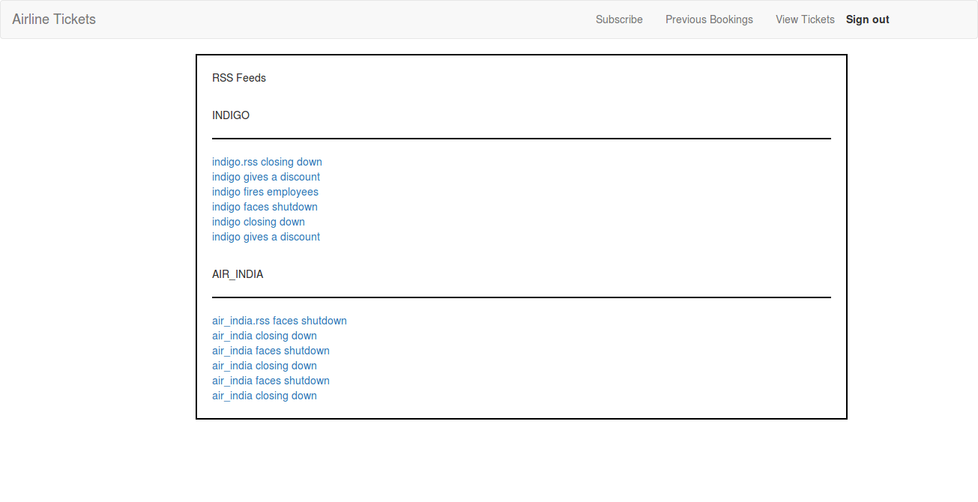
RSS Feed
-Shows the RSS feed.
-The RSS Feed is dynamically updated as soon as there is a change.

Slide 8
Thank You

